Slide 1

Learn Languages 2021
Learn Languages
Language Update / Go
辻大志郎（フューチャー株式会社）
伊藤真彦（フューチャー株式会社）
The Gopher character is based on the Go mascot designed by Renée French

Slide 2
table of contents
Learn Languages
自己紹介
Goとは、Goの特徴
業務でGoを採用した結果
Go1.11～1.17の主なLanguageUpdate
Goを学ぶために
Language Update / Go

Slide 3
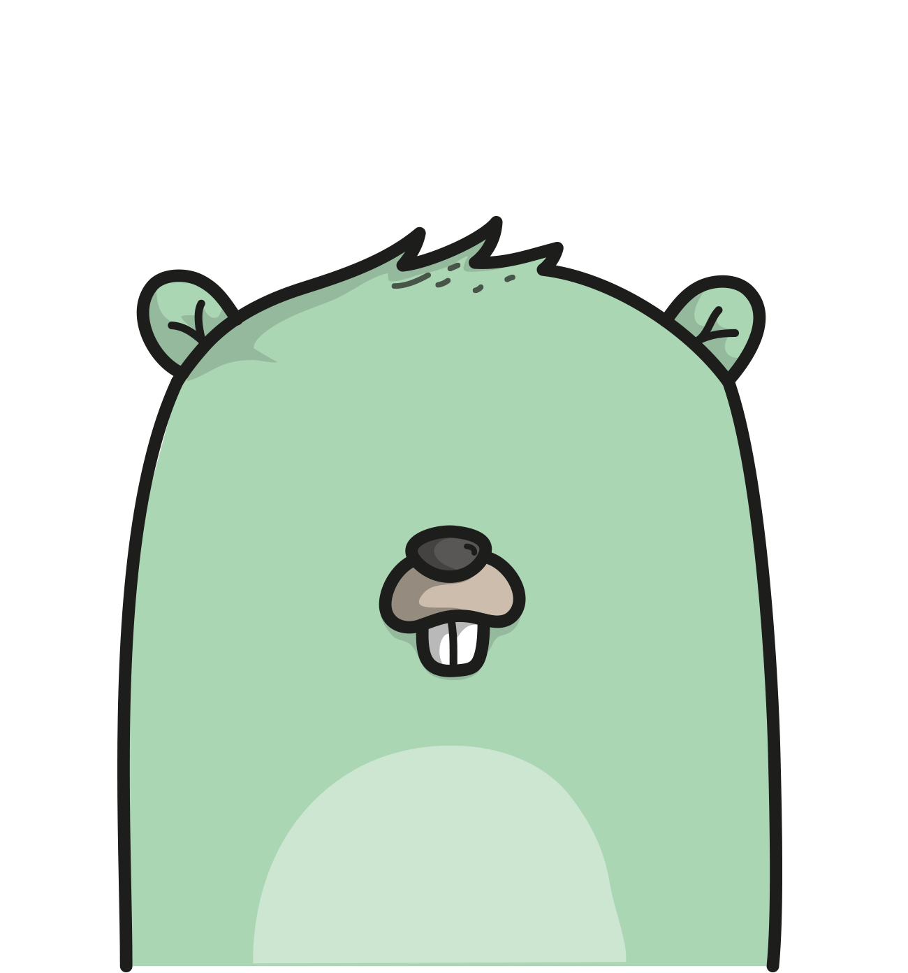
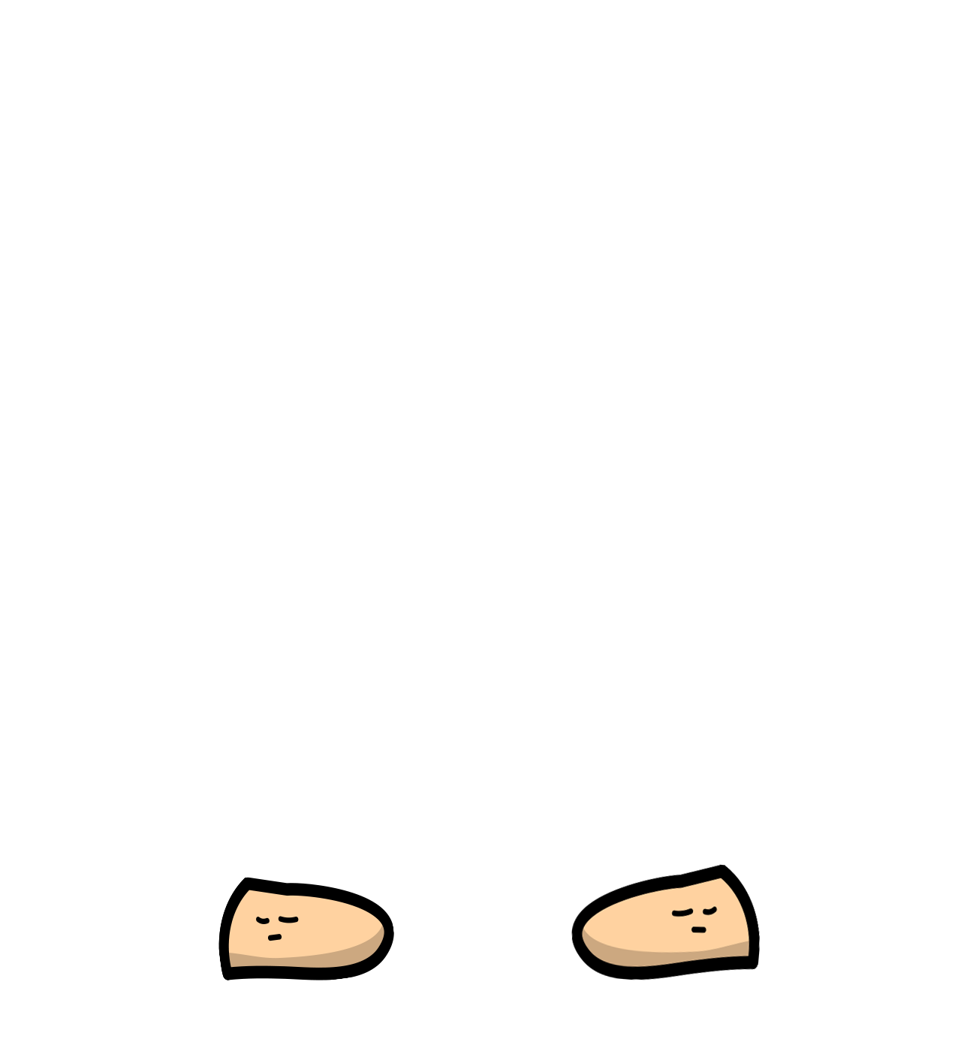

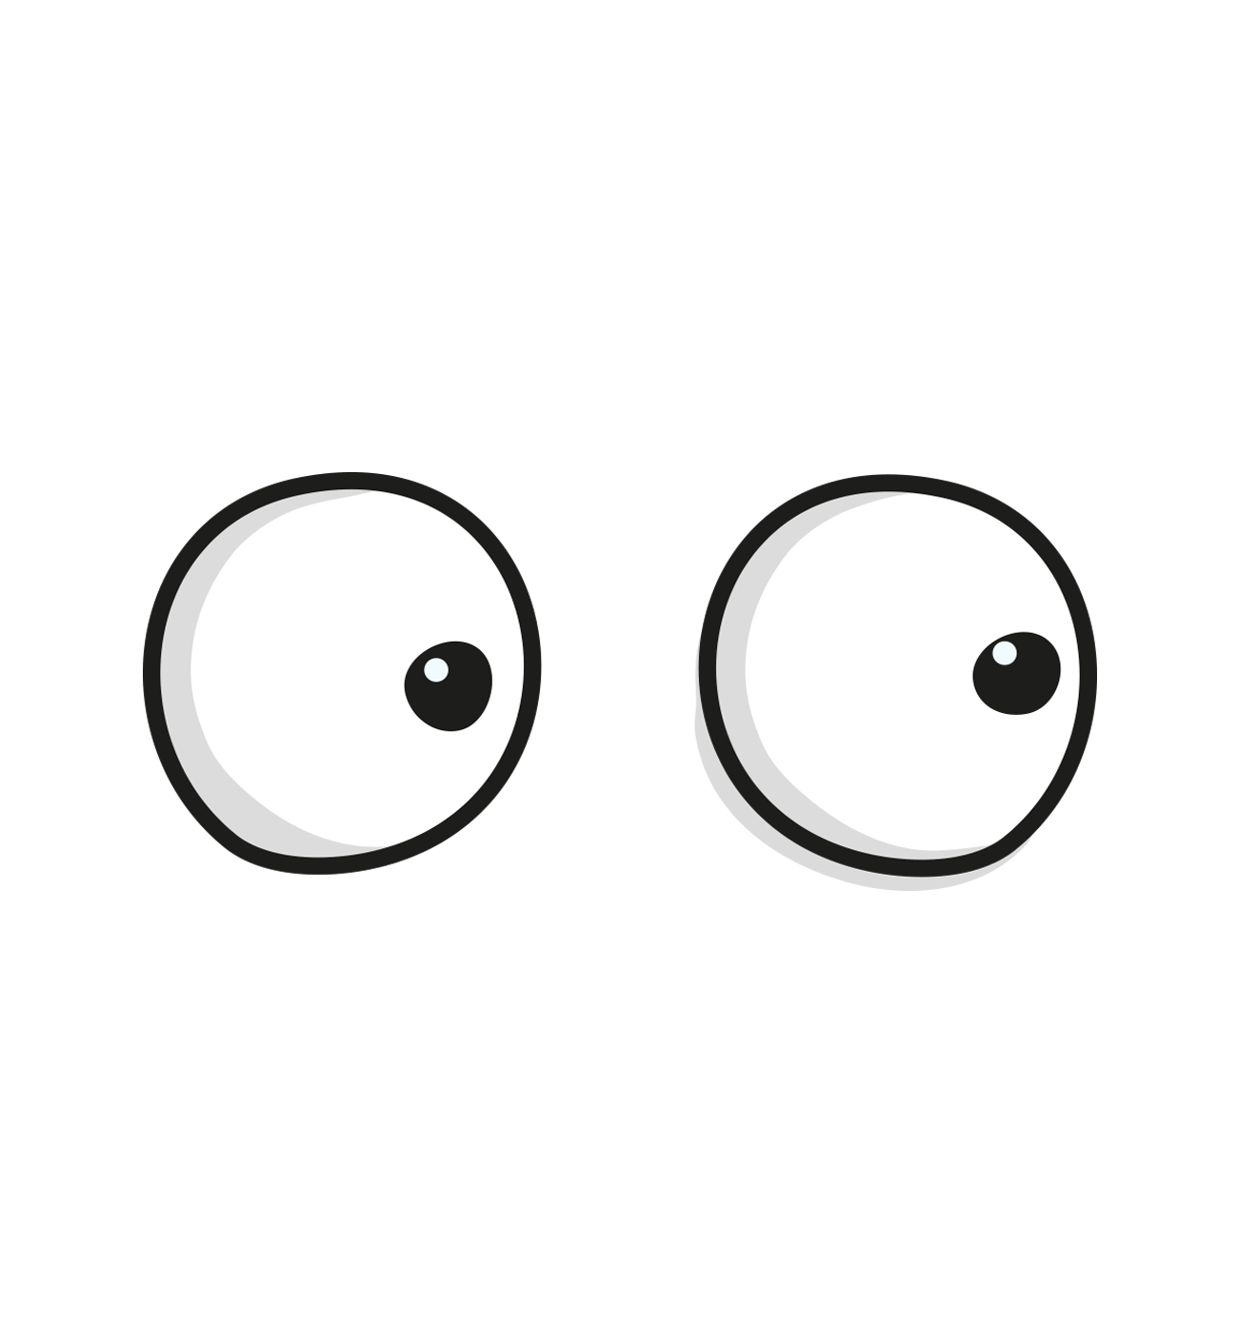

自己紹介
Learn Languages
Language Update / Go
The Gopher character is based on the Go mascot designed by Renée French

Slide 4
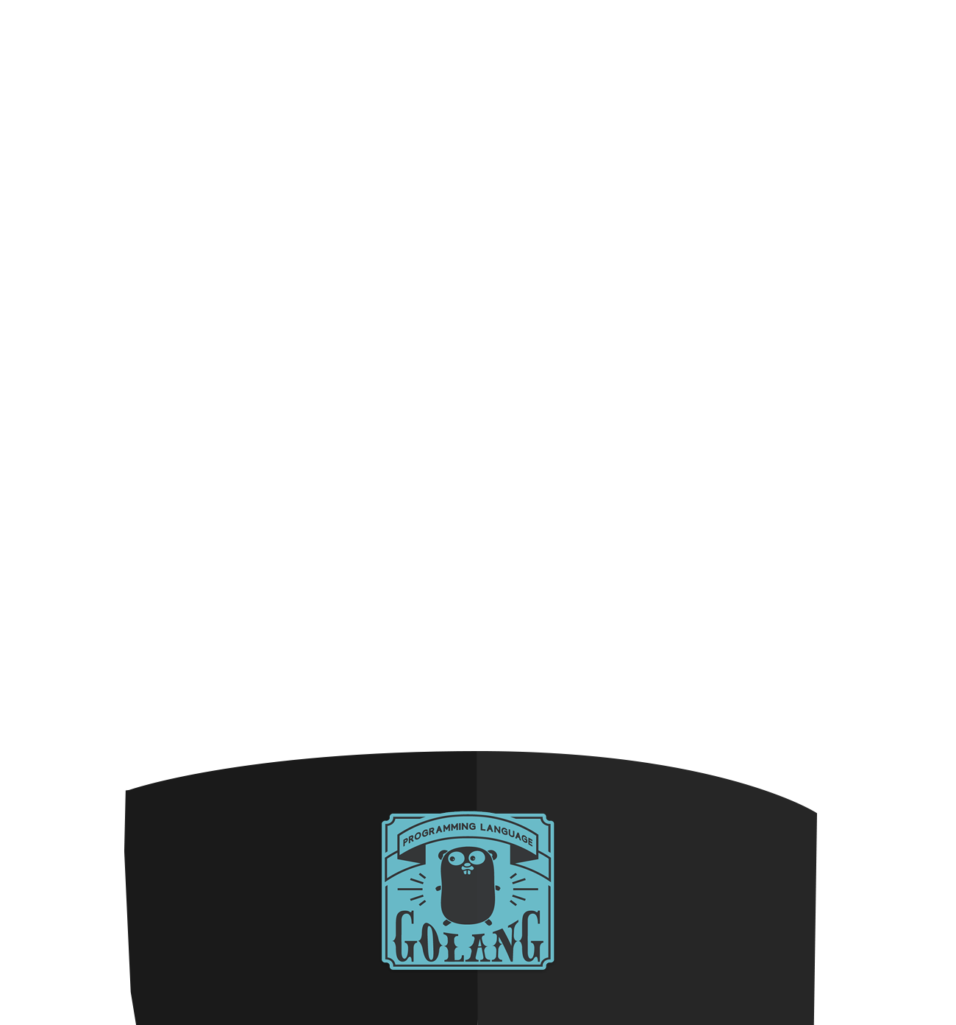
Goとは、Goの特徴
Learn Languages
Language Update / Go
The Gopher character is based on the Go mascot designed by Renée French

Slide 5
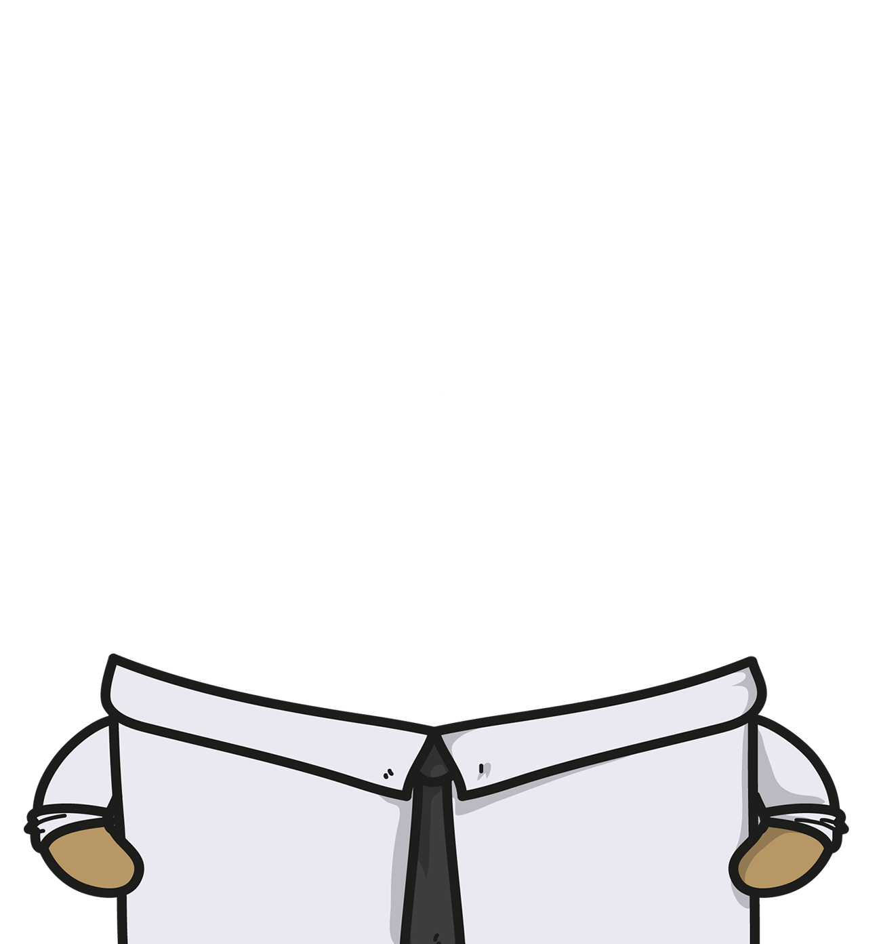

業務でGoを採用した結果
Learn Languages
Language Update / Go
The Gopher character is based on the Go mascot designed by Renée French

Slide 6
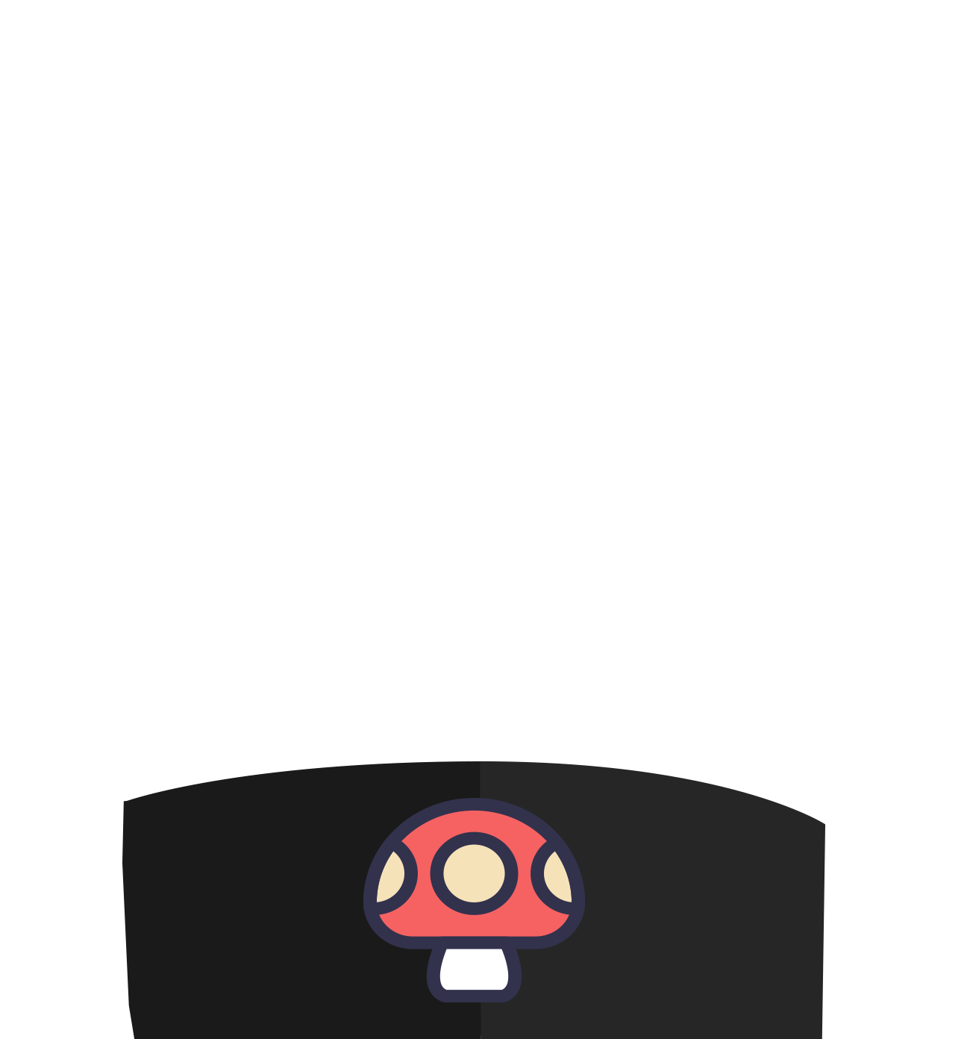
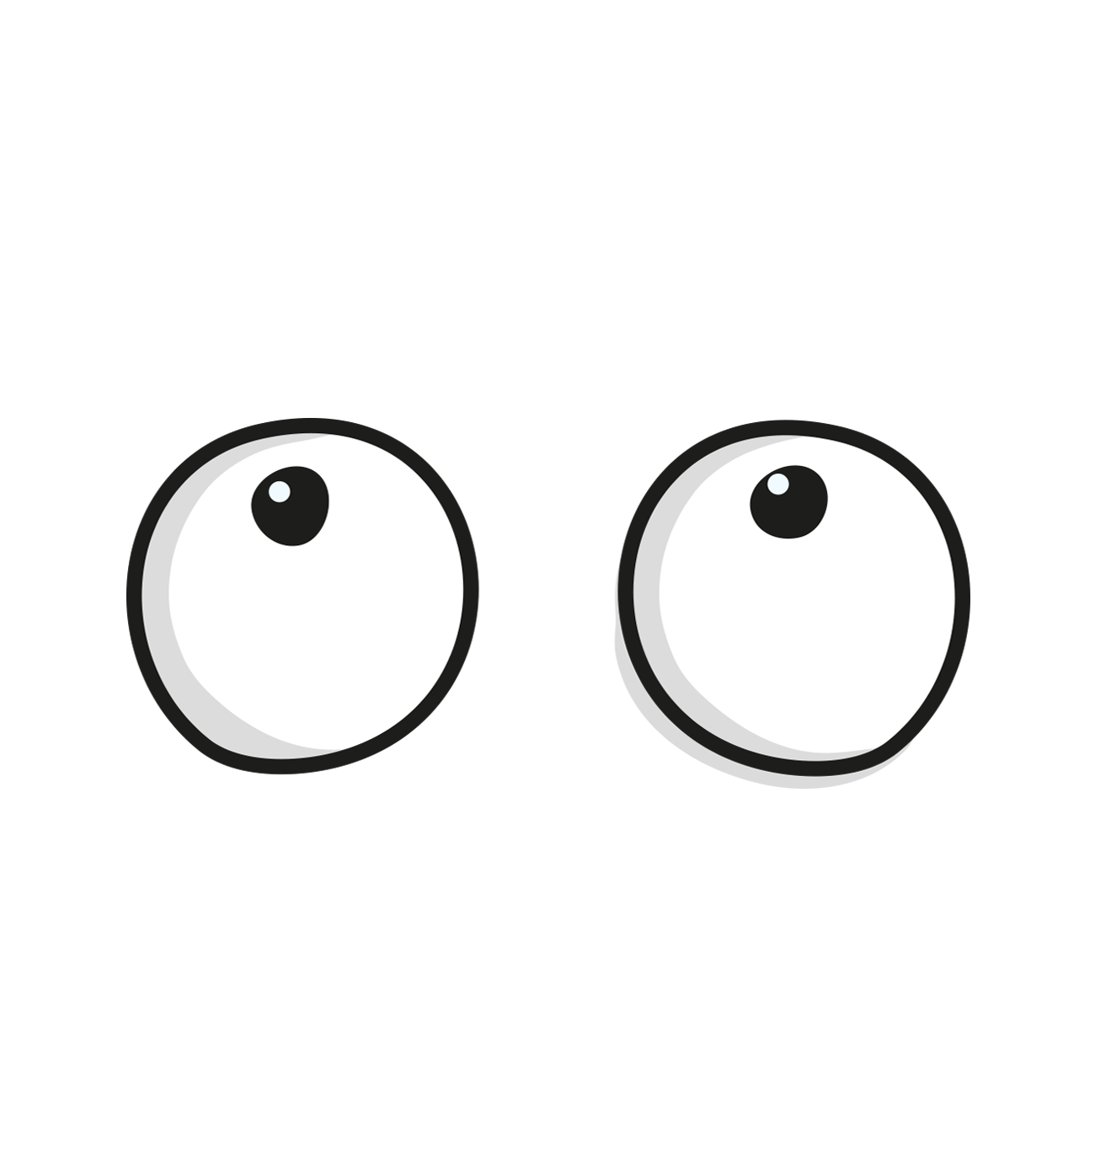
Go1.11～1.17の主なLanguageUpdate
Learn Languages
Language Update / Go
The Gopher character is based on the Go mascot designed by Renée French

Slide 7

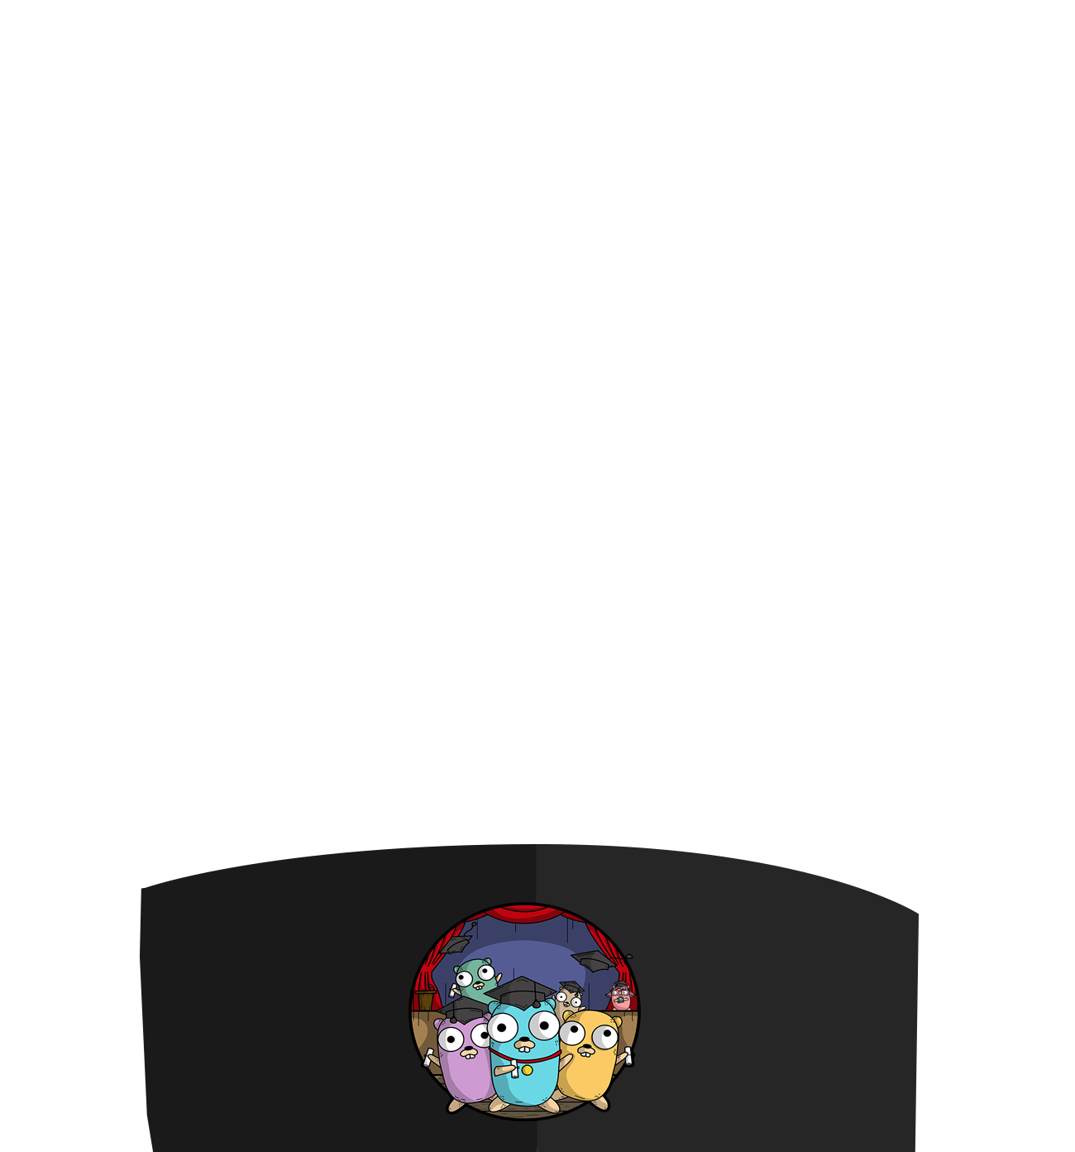
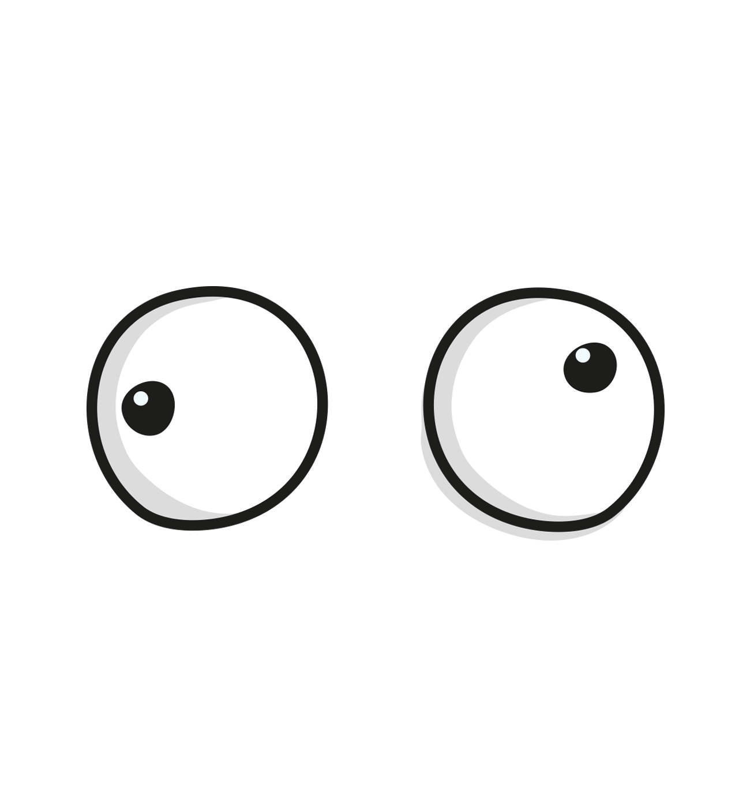
Goを学ぶために
Learn Languages
Language Update / Go
The Gopher character is based on the Go mascot designed by Renée French

Slide 8
Thanks!!
Learn Languages
Language Update / Go
辻大志郎（フューチャー株式会社）
伊藤真彦（フューチャー株式会社）
The Gopher character is based on the Go mascot designed by Renée French

